Slide 1


WindowBuilder
Guillermo Esquivel González
Nicolás Hernández González
Programación de Aplicaciones Interactivas
Notes:
5/7/17
1
1

Slide 2
Index
What will we talk about?
What is WindowBuilder
How to install WindowBuilder
Distribution of the window
Short introduction for a quick start
Features
Wizards
Examples
Notes:
5/7/17
2
2

Slide 3
What is WindowBuilder?
Java GUI designer
Makes easy creating complicated windows
Visual Designer and Java Code
Drag-and-Drop
Add event handlers
Notes:
5/7/17
3
3

Slide 4
Installation
In Eclipse, click Help > Install New Software…
Get the proper link from http://www.eclipse.org/windowbuilder/download.php
In the Available Software dialog, enter the product's update site location and select all the items to install. Click Next to continue.
Click Next to confirm installation.
Accept the license agreement. Click Finish.
Restart Eclipse.
Notes:
5/7/17
4
4

Slide 5
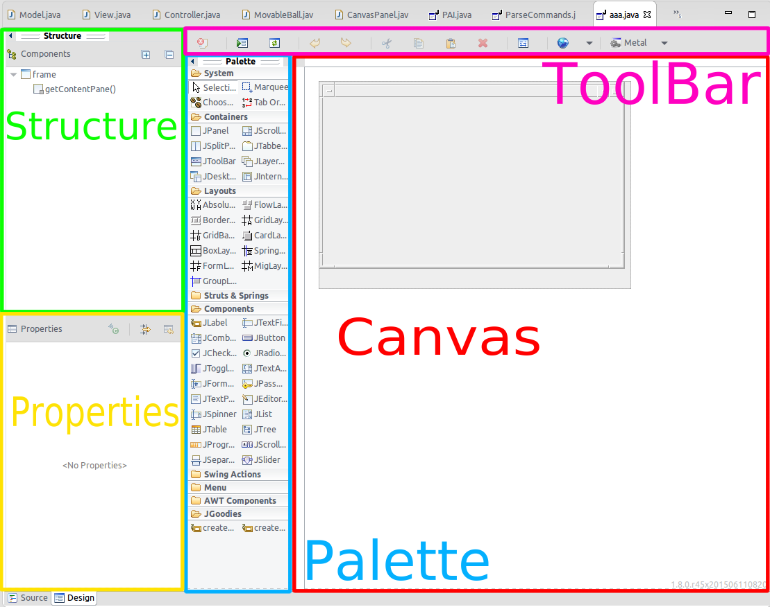
Distribution of the window
Design View
Source View
Structure View
Component Tree
Property Pane
Palette
Toolbar
Context Menu
Notes:
5/7/17
5
5

Slide 6
Short introduction for a quick start
Create a new project using the appropriate project wizard
Notes:
5/7/17
6
6

Slide 7
Short introduction for a quick start
Use class wizard to create your GUI window
Notes:
5/7/17
7
7

Slide 8
Short introduction for a quick start
A class with some existing code is created.
Notes:
5/7/17
8
8

Slide 9
Short introduction for a quick start
To use the windowBuilder click on the "Design tab" at the bottom of the editor
Notes:
5/7/17
9
9

Slide 10
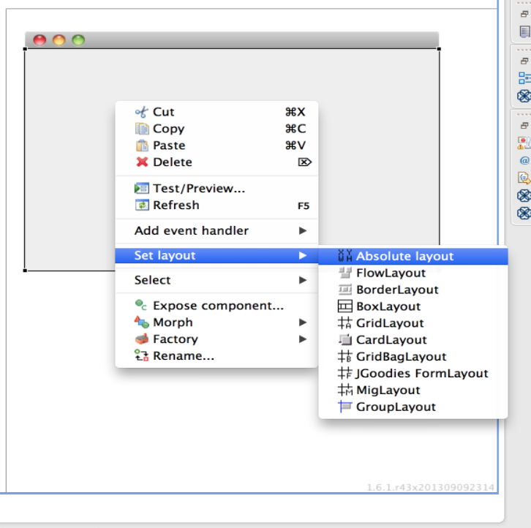
Short introduction for a quick start
To set layout, right click on the window frame and select " set layout " and select the appropriate layout
Notes:
5/7/17
10
10

Slide 11
Short introduction for a quick start
Add various components from the Palette and edit their properties using the Property Pane.
Notes:
5/7/17
11
11

Slide 12
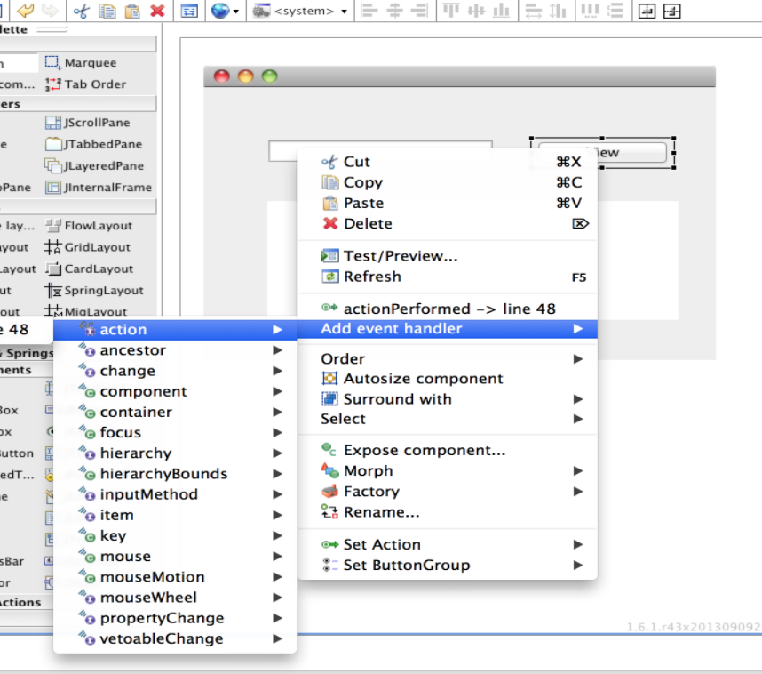
Short introduction for a quick start
Add event handler to various widgets to provide behavior
Notes:
5/7/17
12
12

Slide 13
Tips & Tricks
Directly editing widget text in the design view
Adding multiple widgets of the same type
Editing properties of multiple widgets at the same time
Cofiguring the palette
Editing advanced widget properties
Reverting a widget property to its default value
Hiding code from the parser
Notes:
5/7/17
13
13

Slide 14
Features
Bi-directional Code Generation
Directly generates Java code
The tool can read and write almost any format
Reverse-engineer most hand-written Java GUI code.
Notes:
5/7/17
14
14

Slide 15
Features
Internationalization (i18n)
Directly generates Java code
The tool can read and write almost any format
Reverse-engineer most hand-written Java GUI code.
Notes:
5/7/17
15
15

Slide 16
Features
Custom Composites & Panels
Embed any Composite of Jpanel subclass in another window.
All widgets defined in the are isible in the window they are used.
Access any widget exposed via public accesors.
Access exposed custom properties
Exposed widgets appear in tree with the “exposed” decorator
Notes:
5/7/17
16
16

Slide 17
Features
Factories
Create a static factory method from any widget
Factory methods may be parametrized with one or more arguments
Morph any widget into a factory instance
Add any factory component to the palette
Notes:
5/7/17
17
17

Slide 18
Features
Visual Inheritance
Inherit from any Shell, Composite, JFrame, Jdialog, Japplet or JPanel subclass.
All inherited widgets are visible
Access inherited widgets exposed via public or protected accesors
Access inherited custom properties
Inherited widgets appear in tree with the exposed decorator
Notes:
5/7/17
18
18

Slide 19
Features
Event Handling
Adding an Event Handler
First way is trough the property pane
Second way is to simply right-click on a component, select add event handler.
Deleting an Event Handler
Select the component tree
In the property pane, click the method you wish to delete and then press delete.
Notes:
5/7/17
19
19

Slide 20
Features
Menu Editing
Menus are a must for just abaout all GUIs.
Only SWT Shells, SWT Applications Windows, and Wing JFrames supports menubars.
Each window can have at most one Menu Bar, and the only place that you can put a Menu Bar is directly on a window.
Notes:
5/7/17
20
20

Slide 21
Features
Widget Morphing
The editor allows you to morph similar components from one type to another.
Notes:
5/7/17
21
21

Slide 22
Features
Editing Existing Windows
Open a file that has not been created by the tool, simply right-click on the file and select Open With > WindowBuilder Editor
Notes:
5/7/17
22
22

Slide 23
Wizards
Swing
JFrame
JPanel
JDialog
JApplet
JInternalFrame
Application Window
Automatic Data Binding
Notes:
5/7/17
23
23

Slide 24
Data Binding
How WindowBuilder help us?
Relieves the user from writing and registering listeners himself.
Provides a common infrastructure for validation and conversion.
It makes it easy to connect data sources to widgets.
Notes:
5/7/17
24
24

Slide 25
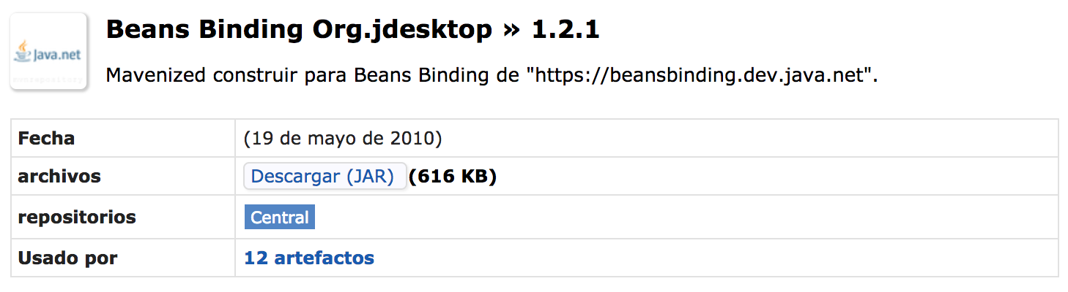
Data Binding
We have to import a JAR file to use dataBinding.
https://mvnrepository.com/artifact/org.jdesktop/beansbinding/1.2.1
Notes:
5/7/17
25
25

Slide 26
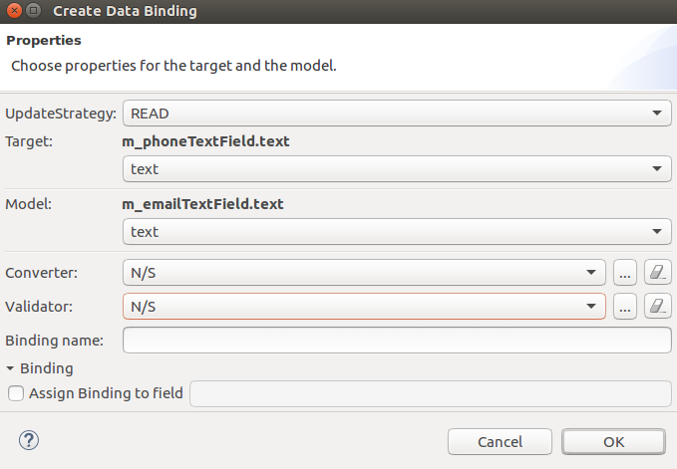
Data Binding
Notes:
5/7/17
26
26

Slide 27
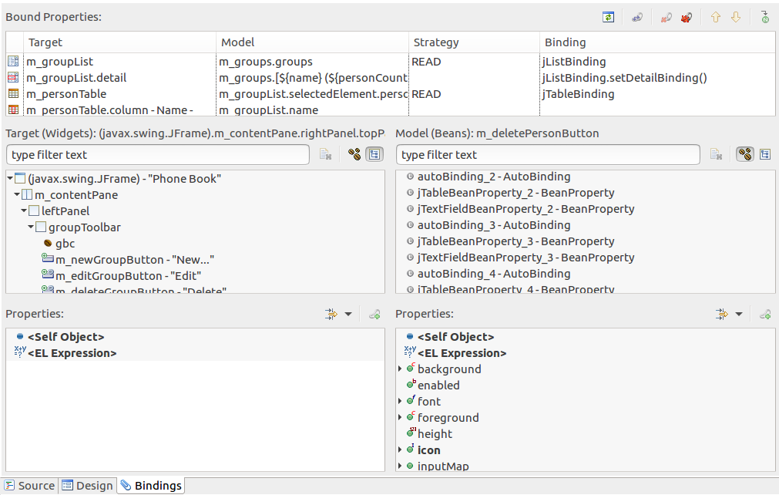
Data Binding
Notes:
5/7/17
27
27

Slide 28
Bibliography
Help eclipse
Eclipse windowBuilder
Eclipse proposals windowBuilder
Notes:
5/7/17
28
28

Slide 29

END
THANKS!
You can find as alu0100881677 & alu0100898293
Slides and code at Github repo
Notes:
5/7/17
29
29

